Slide 1
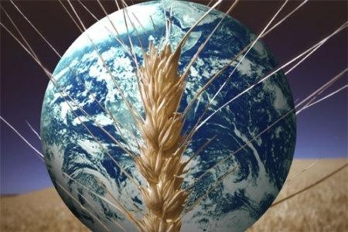
Food Resources
Dr. Nikhil K. Kothurkar
Associate Professor,
Center of Excellence in
Advanced Materials and Green Technologies
Dept. of Chemical Engineering & Materials Science,
Amrita Vishwa Vidyapeetham,
Coimbatore -641112

Slide 2
Outline
Dimensions of the Food Crisis
Hunger, poverty, production, distribution
Threats to Food Security: Present and Future
Solutions to the Food Crisis
Theoretical (Present) Solution
Food Distribution
Real Solutions
Industrial Agriculture?
Alternative Agriculture
Vegetarianism
What Can You Do?

Slide 3
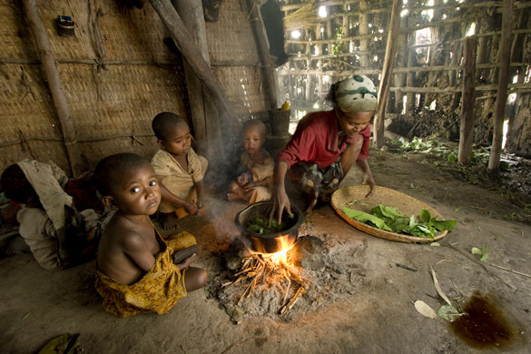
Ayalech can no longer afford maize after a 600% rise in food prices in Ethiopia. She cooks wild cabbage for her hungry and malnourished children. http://www.theguardian.com/society/gallery/2009/mar/31/g20-food-prices-africa

Slide 4
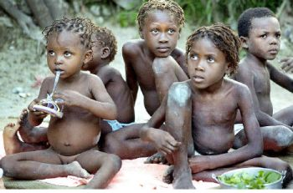
Forced to eat dirt!
Brittle, gritty and revolting, “mud cakes” have been consumed by impoverished pregnant women seeking calcium, for years. But now the cakes have become a staple for entire families in Haiti.
--The Hindu, Wed, Jul 30, 2008

Slide 5
Food and Health in India
India ranked 15th in the 2011 Global Hunger Index (GHI) Report.^{[ref]}
GHI went up from 22.9 to 23.7 between 1996 -2011.
60% of India’s children below the age of three were malnourished (2005 report ^{[ref]} )
1 in 3 malnourished children in the world lives in India.
1.72 mi. children (<1 yr.) die each year before turning one.^{[18]}
Rampant diseases such as dengue, hepatitis, tuberculosis, malaria and pneumonia.^{[ref]}

Slide 6
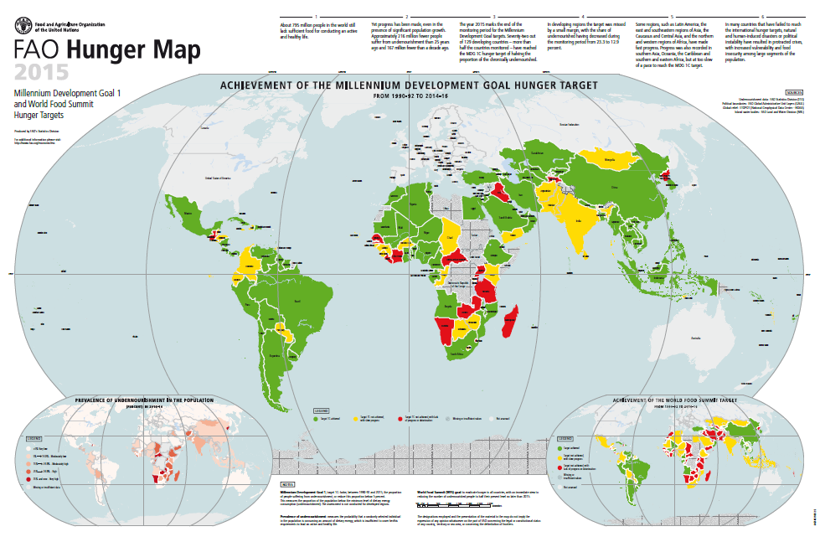
~795 mi. people starving.
http://www.fao.org/3/a-i4674e.pdf

Slide 7
World Food Production
Actually the world is producing enough food to feed everyone for now.
Per capita food availability has risen:
From ~2220 kcal/person/day in the early 1960s
To 2790 kcal/person/day in 2006-08.
Yet many people in the world still do not have sufficient income to purchase (or land to grow) enough food.
Besides, population is projected to grow from 7bi. to 9.6 bi. (2012-2050).
>50% will occur in sub-Saharan Africa, where 25% population is currently undernourished.
http://www.worldhunger.org/articles/Learn/world%20hunger%20facts%202002.htm

Slide 8
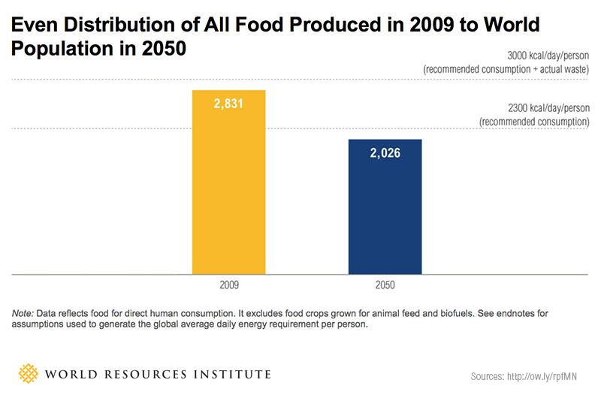
Per Capita Food Availability
http://www.wri.org/blog/2013/12/global-food-challenge-explained-18-graphics

Slide 9
Inequality in Society
Nearly 1/2 of the world’s population (> 3 bi.) live on <$2.50/day.
More than 1.3 bi. <$1.25 a day.
80% of the world population lives on less than $10 a day.
1 bi. children worldwide are living in poverty.
22,000 children die each day due to poverty (UNICEF)
805 mi. worldwide do not have enough food to eat.
The world's 358 billionaires have assets exceeding the combined annual incomes of countries having 45 percent of the world's people.
http://worldcentric.org/conscious-living/social-and-economic-injustice

Slide 10
Spare Arms and Feed the Hungry
Is solving the hunger problem impossible?
….Perhaps not!
For the price of one missile, a school full of hungry children could eat lunch every day for 5 years
100 mi. child hunger deaths (over 1 decade: 1990-2000) could be prevented for:
the price of 10 stealth bombers, or
World military expenditure in 2 days!

Slide 11
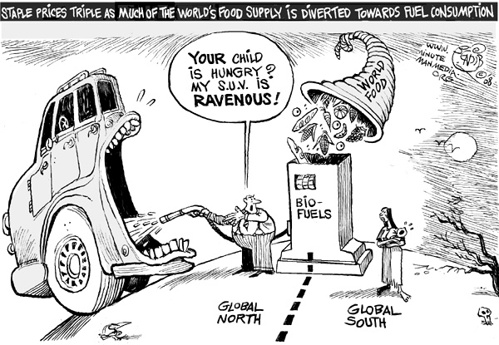

Slide 12
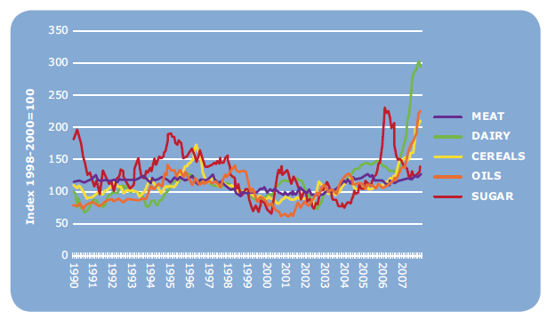
Rising and Fluctuating Food Prices
Monthly FAO Price Indices for basic food commodity groups (1998-2000=100)
The poor consumers and the poor farmers are the worst affected.
Causes:
Losses in yields due to adverse weather conditions
Fluctuations in energy costs
Increased demand due to rising population.
Increased preference for meat and dairy products.
Diversion of food crops and land for biofuel production
Financial speculation and price fixing.^{ref}
Policy factors.
http://www.fao.org/docrep/012/i1059e/i1059e00.pdf, http://www.helsinki.fi/taloustiede/Abs/DP35.pdf
Notes:
Source: International Monetary Fund; U.S. Department of Agriculture.
http://www.usaid.gov/our_work/humanitarian_assistance/foodcrisis/

Slide 13
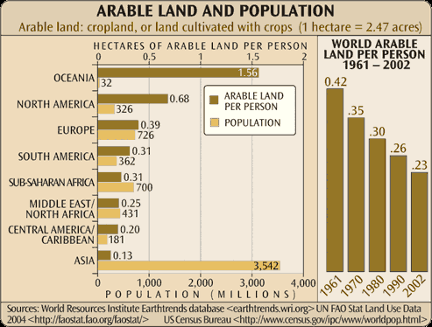
India: 0.13 ha/capita (2012)
http://wdi.worldbank.org/table/3.1

Slide 14
Agricultural Yields in India
Roughly 60% of India’s land is under agriculture.
Indian agricultural yields are generally low due to:
Soil and land degradation.
Low percentage of irrigated land (only 35% of arable land).
Low agricultural technology and know-how.
http://wdi.worldbank.org/table/3.2
http://en.wikipedia.org/wiki/Agriculture_in_India

Slide 15
Food Wastage and Spoilage
1/3rd of world’s food is wasted [ref]; while 0.8 bi. people go hungry.
Millions of tons of foodgrains rot in warehouses
Cold-storage facilities are available for only 10% of India’s perishable food [ref]. 370 mi. tons of perishables at risk.
Large quantities of prepared food is wasted world over.

Slide 16
Outline
Dimensions of the Food Crisis
Hunger, poverty, production, distribution
Threats to Food Security: Present and Future
Solutions to the Food Crisis
Theoretical (Present) Solution
Food Distribution
Real Solutions
Industrial Agriculture?
Alternative Agriculture
Vegetarianism
What Can You Do?

Slide 17
Threats to Future Food Security
Rising population
Unequal distribution
Diversion of foodgrains as livestock feed and biofuels.
Reduced productivity of important agricultural regions world-wide due to desertification, droughts, land degradation, pollution…effects of industrial agriculture, deforestation, industrialization and urbanization.
Global climate change: droughts, famines, floods and severe weather episodes, shifting temperature, rainfall and humidity patterns
Food Wastage and Spoilage
Genetic pollution due to GMOs
Loss of crop and wild biodiversity

Slide 18
Solutions???
So, we must grow more food…drastically improve productivity through technology—
Industrial agriculture: mechanization, chemical fertilizers…pesticides… biotechnology …genetic engineering…
Technology has solved so many problems for us…surely this is no different!…
Right????? ……………………OR NOT??
When in doubt, lets look at our leaders

Slide 19

What are our leaders doing?
G8 Summit on Global Food Crisis and Poverty Alleviation in 2008.
Leading industrialized nations on the island of
Hokkaido, Japan

Slide 20
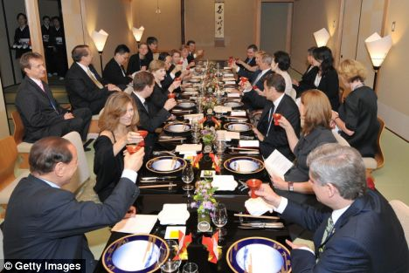
Summit that's hard to swallow
World leaders enjoy an 18-course banquet as they discuss how to solve
Global Food Crisis
http://www.dailymail.co.uk/news/article-1032909/Summit-thats-hard-swallow--world-leaders-enjoy-18-course-banquet-discuss-solve-global-food-crisis.html

Slide 21
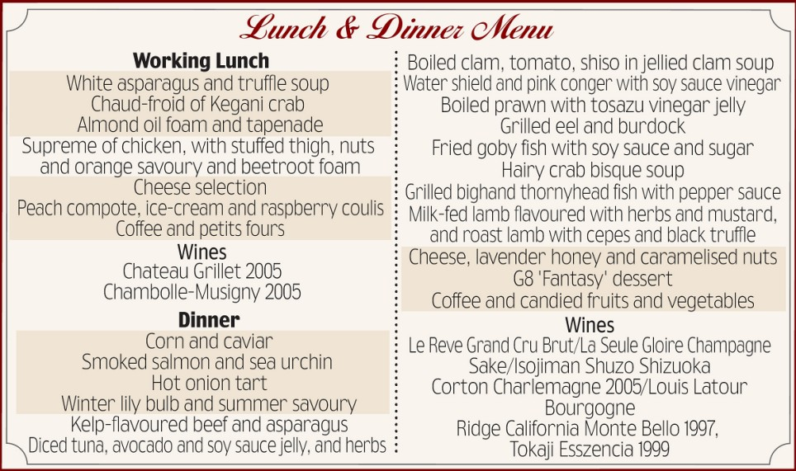
Just what the starving millions need!

Slide 22
Outline
Dimensions of the Food Crisis
Hunger, poverty, production, distribution
Threats to Food Security: Present and Future
Solutions to the Food Crisis
Theoretical (Present) Solution
Food Distribution
Real Solutions
Industrial Agriculture?
Alternative Agriculture
Vegetarianism
What Can You Do?

Slide 23
Theoretical Solution
Since presently the world already produces enough food, the hunger problem can be solved theoretically, to a large extent by better and more equitable distribution.
…easier said than done!

Slide 24
Food Distribution: Haves and Have-nots
Excess food production in developed countries (low population densities); insufficient food production in developing countries (high population densities).
High food prices: unaffordable to the poor countries and the poor people in a country.
Developed countries must enable purchase of food by poor countries at subsidized prices, while offering the producers a fair price for their crop.
The govts. and state depts of poor countries should effectively distribute food to the poor masses at subsidized rates.

Slide 25
Food Distribution and World Debt
The poorest 52 countries (37 in Africa) $376 bi. debt.
This forces the countries to use their land for growing cash crops for export.
This, prevents solving the hunger problem.
Cancelling world debt would will allow them to recover their economy, agriculture, and technology to solve their food crisis.
Will the present world economic order allow this to happen?

Slide 26
Food Distribution: Wars
War, (esp. civil war) is one of the major causes for persistent hunger in a country…often triggered by resource control issues between govts. and dissenting groups.
Destroys or disrupts agriculture, economy, food distribution systems, transportation etc. for extended periods.
Often prevents aid (food and medical aid) entering or reaching those areas of need.

Slide 27
Food Distribution: Wars
Wars divert a nation’s resources to funding the war process.
There is little money to fund equipment, technology to increase food supplies, or to afford imports of food from abroad.
Peace negotiations in hunger stricken areas help to allow aid in and the country to focus its time and resources onto solving their hunger problems.

Slide 28
More tangible improvements in food distribution…..

Slide 29
Food Distribution: Market Facilities and Management
Public market facilities are inadequate or in a derelict condition affecting the local economy, small traders, and consumers.
Many food traders occupy roads around markets.
Traders are taxed by the govt. without providing market facilities.
Rat and pest-infested warehouses…unhygenic and
Insufficient, ill-designed, ill-maintained and high-priced cold storage.
This leads to high spoilage of food and hygiene and safety problems.

Slide 30
Food Distribution: Market Facilities and Management
Poor transportation facilities and road infrastructure, delays at octroi and other check posts, limited refrigerated transportation facilities
Regulation and Taxation: Fruit and vegetables sometimes have to transported through a series of wholesale markets, compulsory middlemen, and a series of market and municipal taxes, leading to high prices.
Corruption in the subsidized distribution system leads to diversion of the subsidized food to the open market at a high prices.

Slide 31
Food Distribution: Food Miles
“Food miles” - the total distance in miles the food item is transported from field to plate
A convenient indicator of sustainability
Has led to a general movement towards local production and local consumption in order to minimize food miles.
It raises fundamental questions about the sustainability of the globalised food trade and the increasing concentration of the food supply chain and distribution in the hands of fewer and fewer transnational corporations.

Slide 32
Food Distribution: Food Miles
Sourcing food locally and preferring seasonal foods. (Avoid foods with high food miles and out-of-season foods)
Local, regional and national food self-sufficiency should be encouraged.
Internalising the social costs of transport to reflect the costs to society of pollution, congestion, accidents, noise and so on, in the prices paid by transport users.
Preventing irrational food trade: identical produce is simultaneously imported and exported between developed countries in Europe and America.
In the name of ‘free trade’, poor and populous countries cultivate cash crops for export to advanced countries, and import their own food supplies.

Slide 33
Food Distribution: Food Miles
This benefits supermarkets, corporations, traders, middlemen, etc.
But an even impoverish the farmer by forcing him into the debt trap of industrial agriculture and undermining their own food security.
It leads to the lengthening of the supply chain, high spoilage rates, high prices for the consumers, high GHG emissions during transportation, refrigeration etc.
Need to improve the wider sustainability of the food supply chain e.g. ethical trading, improved energy efficiency in the local food sector.
Reducing transport impacts e.g. cleaner vehicles, improved logistics, rail freight, etc.

Slide 34
Outline
Dimensions of the Food Crisis
Hunger, poverty, production, distribution
Threats to Food Security: Present and Future
Solutions to the Food Crisis
Theoretical (Present) Solution
Food Distribution
Real Solutions
Industrial Agriculture?
Alternative Agriculture
Vegetarianism
What Can You Do?

Slide 35
Real Solutions to the Food Crisis
A more fundamental, practical and sustainable solution to the food crisis is complex.
There are no simple solutions
It requires a deep understanding of conventional (industrial) agriculture, its economics, socio-economic issues and sustainability
It also requires a deeper understanding of natural processes, ecology, biodiversity, evolution etc.

Slide 36
Can industrial agriculture solve the food crisis?

Slide 37
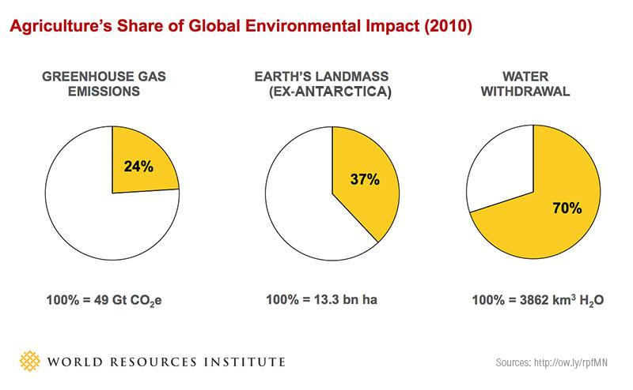
Environmental Impacts of Agriculture
http://www.wri.org/blog/2013/12/global-food-challenge-explained-18-graphics

Slide 38
Conventional Farming
Activity | Environmental Impact
Land clearing | Loss of biodiversity and habitats, topsoil loss, reduced water recharge, CO₂ emissions.
Heavy Equipment | Soil compaction, waterlogging, high cost, oil dependence
Ploughing | Loss of soil structure, porosity, moisture, moisture carrying capacity, biomass/humus, biota; CO₂ emissions
Fertilizers | Fast plant growth & micronutrient deficiency, loss of soil fertility, and biota, eutrophication, nitrates pollution.
Pesticides, Herbicides | Toxicity to man & environment, POC, increased resistance in pests and weeds, ozone depletion (MeBr)
Irrigation | Waterlogging, salination, evaporative losses, CH₄ emissions

Slide 39
Corporate Monopolization of Agriculture
By end of 2001 worldwide:
Top 10 agrochemical corporations…84% of the $30 bi. market
Top 10 veterinary pharmaceutical companies…60% of the $13.6 bi. world market.
10 pharmaceutical companies…48% of the $317 bi. world market.
Only 6 corporations controlled 98% of the world’s market in GM crops.
The same 6 firms also controlled 70% of the world’s pesticide market.
94% of all GM crops grown worldwide were from 1 company’s germplasm: Monsanto’s.
http://www.greens.org/s-r/33/33-03.html

Slide 40
“…The agricultural sciences have over time become increasingly subordinated to capital and…this ongoing process has shaped both the content of research and, necessarily, the character of the products.”
–Jack Kloppenberg rural sociologist in First the Seed.

Slide 41
“What is profitable affects, or even determines, what is ‘scientifically true.’
–Hugo de Vries (biologist)

Slide 42
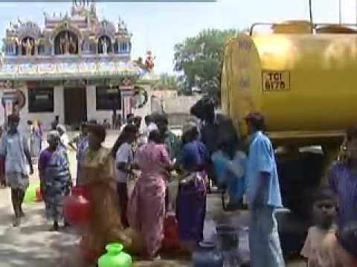
Impacts of Pesticide Use
High preconsumer human health costs to conventional agriculture, particularly in the use of pesticides.
It is estimated that 25 mi. agricultural workers in developing countries are poisoned each year by pesticides.
Watch video:
100% Cotton (35min)
Conway, G. and Pretty, J. N., Unwelcome Harvest: Agriculture and Pollution, Earthscan Publications, London, 1991, p. 645.
Jeyaratnam, J., Acute pesticide poisoning: A major problem. World Health Stat. Q., 1990, 43, 139–144.

Slide 43
Are We Violating the Constitution?
Pesticide use violates the right to life enshrined in Article 21 in our Constitution
Article 47 of the Constitution:
The State shall regard the raising of the level of nutrition and the standard of living of its people and the improvement of public health as among its primary duties and in particular, the state shall endeavor to bring about prohibition of the consumption except for medicinal purposes of intoxicating drinks and of drugs, which are injurious to health.
—Ravi Agarwal, Director, Srishti

Slide 44
More Impacts
Devastation of natural ecosystems
Desertification and loss of topsoil soil
Unfair practices of fertilizer and pesticide companies causing social injustice and suicides
Benefits large corporations and middle men
Impoverishes the poor farmer and makes the consumer unhealthy

Slide 45
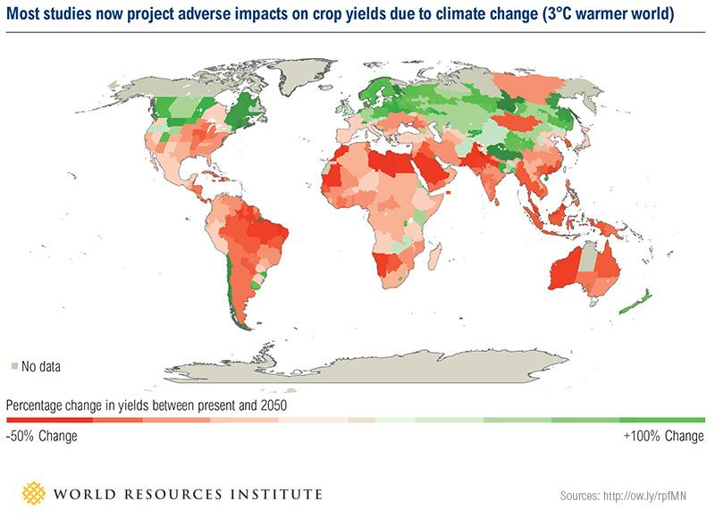
Climate Change To Reduce Yields

Slide 46
Impacts on Land
In the past 20 yrs.:
Tropical forests lost to agriculture: 15 mi. ha/yr
tremendous loss of genetic diversity.
Soil erosion and other forms of land degradation: 5-7 mi. ha of farming land/yr.
Waterlogging and salination: 1.5 mi. ha/yr.
Other damaged land: 30 mi. ha
http://www.i-sis.org.uk/FAOPromotesOrganicAgriculture.php

Slide 47
Impacts on Land: Irreversible Land Degradation
South Asia: ~ 50% land degraded and useless for food production.
China: 27% irreversible loss of land for agriculture, loss rate (2,500 sq. km /year).
Madagascar: 30% of the arable land irreversibly barren.
^ ª ^{b} ^{c} Ron Nielsen, The Little Green Handbook, Picador, New York (2006) ISBN 0-312-42581-3
^ UNEP, Global Environmental Outlook 2000, Earthscan Publications, London, UK (1999) which may also be viewed at http://www.unep.org/geo2000/ov-e/index.htm, including an optional PDF download

Slide 48
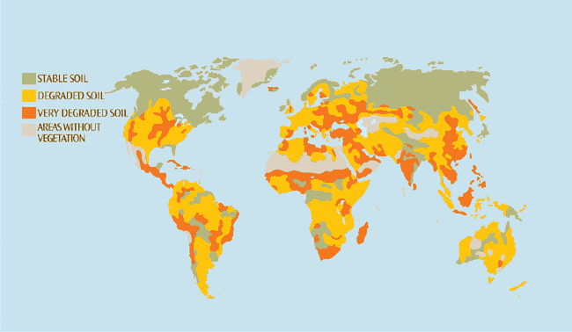
World Soil Degradation
About 2 bi. ha of soil, (~15% of Earth's land area), an area larger than the United States and Mexico combined, have been degraded through human activities.
http://www.theglobaleducationproject.org/earth/food-and-soil.php

Slide 49
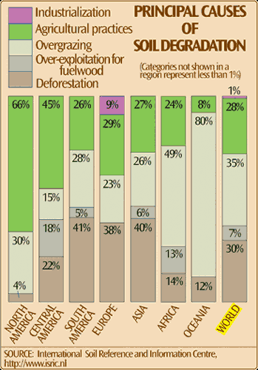
http://www.theglobaleducationproject.org/earth/food-and-soil.php

Slide 50
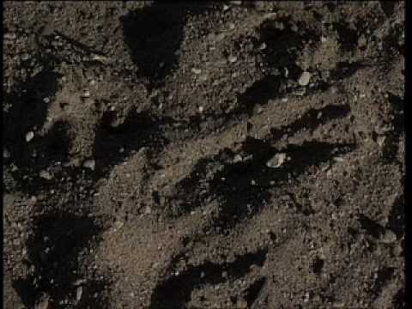
Watch Video: Soil: Who Needs It? (14)

Slide 51
Soil Carbon Sink
Soils contain ~1,395 gigatons of C; Vegetation ~650 gigatons, atmosphere ~750 gigatons…(United Nations Food & Agriculture Organisation)
"Soil organic carbon is the largest [terrestrial C] reservoir in interaction with the atmosphere."
It includes plant litter, burnt char, other biomass and humus (organic carbon polymers, lignin, aliphatic compounds, waxes and terpenoids)
More organic matter tends to accumulate in the litter and soils of colder regions boreal forests and Taiga.
http://www.nature.com/nature/journal/v298/n5870/abs/298156a0.html
^ Swift, Roger S. (November 2001). "Sequestration of Carbon by soil". Soil Science 166 (11): 858–71. doi:10.1097/00010694-200111000-00010. http://www.soilsci.com/pt/re/soilsci/abstract.00010694-200111000-00010.htm.
^ Batjes, Niels H. (1996). "Total carbon and nitrogen in the soils of the world". European Journal of Soil Science 47: 151–63. doi:10.1111/j.1365-2389.1996.tb01386.x.
^ Klaus Lorenza, Rattan Lala, Caroline M. Prestonb, Klaas G.J. Nieropc (15 November 2007). "Strengthening the soil organic carbon pool by increasing contributions from recalcitrant aliphatic bio(macro)molecules". Geoderma 142 (1-2): 1–10. doi:10.1016/j.geoderma.2007.07.013.

Slide 52
Loss of Soil Carbon
Agricultural practices such as tilling, exposing soil to the sun and burning lead to high soil temperatures, disruption of plant root systems, destruction of soil microflora and fauna…leading to oxidation of humus—C-emissions.
Deforestation and burning leads to huge emissions of carbon.
Water logging/submergence of forests and soils (esp. peat bogs) releases huge amounts of carbon in the form of CO₂ and CH₄.
C-sink capacity of the world's agricultural and degraded soils is 50 to 66% of the total historic carbon loss of 42 to 78 gigatons C

Slide 53
Loss of Crop and Wild Biodiversity
Monopolization of agriculture by seed and agrochemical MNCs
Extensive crop monocultures
Loss of highly adapted and diverse indigenous crops and landraces
Reduced resilience to changing climate
More susceptible to MNCs power politics
Reduced independence for farmer.
Debt trap

Slide 54
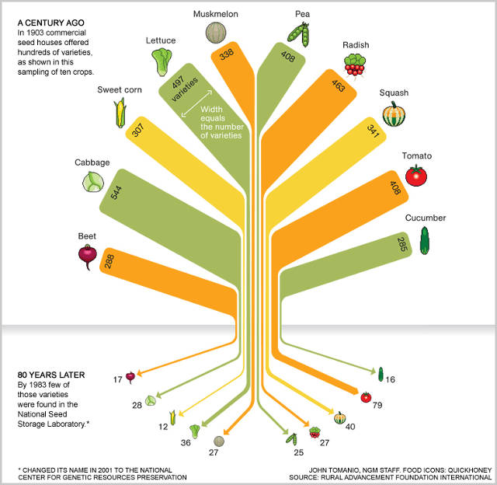
http://g.fastcompany.net/multisite_files/codesign/imagecache/inline-large/post-inline/food-variety-tree-754.jpg

Slide 55
Risks of Genetically Modified Organisms (GMOs)
“Genetic engineering is not merely causing genetic pollution of biodiversity and creating bio-imperialism, monopolies over life itself. It is also causing knowledge pollution—by undermining independent science, and promoting pseudo science. It is leading to monopolies over knowledge and information.”
–Dr Vandana Shiva | Author, Activist, Pioneer, Scientific Advisor, Mother
Navdanya www.navdanya.org/
Watch Video: Seed Freedom (2.29)

Slide 56


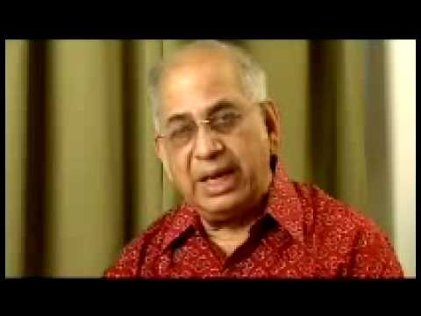

Risks of GMOs
Part 1
Part 2
Part 3
Part 4
Documentary: Poison on a Platter by Mahesh Bhat (30 min)

Slide 57
External Costs of Industrial Agriculture
Industrial agriculture and the green revolution has masked significant externalities, affecting natural resources and human health as well as agriculture itself.
Environmental and health problems associated with agriculture have been increasingly well documented
External costs of agriculture in the UK alone have been estimated as 1.1–3.9 bi. pounds/yr.
As the external costs of farming are not internalized in the price of food, tax payers (or more likely the future generations) will have to pay the bill that is getting bigger every day.
Subba Rao, I. V., Soil and environmental pollution – A threat to sustainable agriculture. J. Indian Soc. Soil Sci., 1999, 47, 611–633.
Pretty, J., The real costs of modern farming. Agric. Syst., 2000, 65, 113–136

Slide 58
Summing Up Corporate Agriculture
Agriculture related firms form a nexus: Seed firms; agrochemical concerns; agroforestry; veterinary services and medicine; food industry; biotechnology; pharmaceuticals; nanotech, bioinformatics.
Capitalized market valued between $2.5–4 trillion.
Approximately 12 firms control 75% of this market.
These corporations are not committed to humanitarian ends—i.e., feeding and curing people, or tackling hunger or disease.
Instead, they are committed to feeding themselves and their shareholders increasing profits, making well people better, and fomenting simultaneously social sickness and corporate wealth.
The name of the game is, privatize benefits and socialize costs.
http://www.greens.org/s-r/33/33-03.html

Slide 59
Death Trap of Industrial Agriculture
70% of all Indians are small marginal farmers with land holdings of a few acres or less.
Giant seed and agrochemical MNCs market expensive seeds to them promising extraordinary yields, quality and profits.
However, the crops are addicted to high water use and agrochemical inputs such as fertilizers and pesticides …often marketed by the same MNCs.
Majority of introduced commercial crops (esp. hybrids and GMOs) are not adapted to local conditions.
Watch Video: Nero's Guests (56min)

Slide 60
Death Trap of Industrial Agriculture
These crops are more vulnerable to climatic changes, disease and pest attack.
Farmers are urged to turn traditional diverse farms into cash crop monocultures.
MNCs also aggressively market farm machinery in the name of higher productivity and profits.
Forces farmers to borrow; oft. at unreasonably high interest rates (30-60% p.a.) from private moneylenders.
Produce is sold by farmers in a market controlled by traders and MNCs, and which is subject to price-fixing and the vagaries of government policies.

Slide 61
Death Trap of Industrial Agriculture
Farmers cannot indulge in "unauthorized seed-saving”. Patent violation…lawsuits.
F1 hybrids, Terminator Technology (sterile seeds).
Must purchase seed for the next season from the seed corporation…at ever-increasing prices.
Newer seeds need higher and higher inputs of newer and deadlier pesticides and fertilizers…purchased from the same MNCs.
Repeated borrowing becomes necessary
Crop failures or inability to sell crops at a suitable price causes the debt to spiral out of control…farmer suicides.

Slide 62
Death Trap of Industrial Agriculture
The excessive fertilizers lay waste the land…depleted soil carbon, deficiency of micronutrients, loss of soil biota, eutrophication and pollution of waterways.
Excessive irrigation: water logging, salinization of soils, groundwater depletion.
Excessive pesticides, herbicides: pollution of air, land and water,
Heavy farm machinery: soil compaction (plough pan) water logging.

Slide 63
Indian Farming: Cost Breakup
S. No. | Item | %Cost
1. | Seed | 20
2. | Chemicals | 32
3. | Diesel (groundwater pumping) | 10
4. | Labor | 38
 | TOTAL INPUT COST | 100
Avg. potato and onion farming in Northern India
http://www.globalresearch.ca/index.php?context=va&aid=3204

Slide 64
Indian Farming: Cost Breakup
Assuming 4.4 metric tonnes/acre each of potato and onion
5 yr-avg. ex-farm prices is about Rs. 200/quintal for potato and Rs. 250/quintal for onion.
Does not include post-harvest wastage: 10 to 40% on account of drying, rotting, and losses in transit (various government estimates).
Once in ~3 yrs. prices crash by as much as 30-50%, largely engineered by traders, leaving farmers deeply in debt.

Slide 65
Indian Farming: Cost Breakup
Input Rs./acre | Output Rs./acre | Interest owed | Profit Rs./acre | Remarks
38,000 | 44,500 | 0 | 6,500 | Self-financed, Hired Labor
23,560 | 44,500 | 0 | 20,900 | Self-financed, Family Labor
38,000 | 44,500 | 6,840 | -340 | 50% inputs financed @36% p.a., Hired Labor
23,560 | 44,500 | 6,840 | 14,100 | 50% inputs financed @36% p.a., Family Labor
38,000 | 31,150 | 6,840 | -13,690 | 50% inputs financed @36% p.a. 30% crash in market price
23,560 | 31,150 | 6,840 | 750 | 50% inputs financed @36% p.a. 30% crash in market price, Family Labor
http://www.globalresearch.ca/index.php?context=va&aid=3204

Slide 66
Indian Farming: Cost Breakup
Small and marginal farmers cannot store the produce or afford warehouse charges.
Distress sale further erodes a farmer’s financial viability.
Those who store their surplus end up losing 10-20% stock due to spoilage and drying shrinkage.
This neutralizes any gains through seasonal price fluctuation.

Slide 67
Ineffective Government Policies
“The talk of helping farmers with greater access to market, a promise that has been repeated by every politician and every Agriculture Minister since 1947, is unlikely to resolve the problem of assured minimum income. Small and marginal farmers can’t benefit from market access; rather the market left to its own devices works against their interest.”
—Arun Shrivastava, Global Research, 2006
http://www.globalresearch.ca/index.php?context=va&aid=3204

Slide 68
Indian Farming: Winners and Losers
Income from… | USD / acre/yr
Seeds | 168.89
Diesel | 84.45
Fertilizers and pesticides | 270.23
Total to corporations | 523.57
Corporations
Net income | USD /acre/ yr
With hired labor | 144.00
With family labor [excluding cost of capital] | 464.00
Farmers
70% of Indians

Slide 69
Industrial Agriculture Leads to Food Insecurity
Unsustainable yields.
Yields decline due to soil degradation, pest attack (pesticide resistance)
Increased agrochemical use becomes necessary…expensive
Needs excessive irrigation…resource depletion and land degradation.
Leads to crop monocultures: inherently unstable
Degradation of prime agricultural lands, loss of topsoil—a permanent loss.
Poor resilience to changing abiotic and biotic factors…global climate change.

Slide 70
Industrial Agriculture Leads to Food Insecurity
Serious and widespread preconsumer and consumer health effects of pesticides, nitrate contaminants.
Eutrophication and toxification of precious and scarce water resources.
Inequitable food distribution inspite of surplus production due to MNC domination, politics and govt. policies.

Slide 71
Outline
Dimensions of the Food Crisis
Hunger, poverty, production, distribution
Threats to Food Security: Present and Future
Solutions to the Food Crisis
Theoretical (Present) Solution
Food Distribution
Real Solutions
Industrial Agriculture?
Alternative Agriculture
Vegetarianism
What Can You Do?

Slide 72
Human System vs Ecosystem
Anthroposystem
Very simple ecosystem; max. 3 trophic levels
Open system; minimal recycling
High efficiency of transfer of biomass to higher trophic level
Monoculture; high density
Few favored species encouraged; weeds destroyed
Static, highly unstable
Few people feed the rest-agriculture
Ecosystem
Often highly complex food webs
Often closed systems with significant recycling
Low efficiency of transfer of biomass to higher trophic level
High biodiversity
Natural balance in species populations achieved adapted to conditions
Robust, stable, dynamic, adaptable, evolving

Slide 73
Problems with Human Systems
Dependent on very few species
80% of world food from 15 species.
Human consume only 150 out of the estimated 50,000 edibles.
Out of 10,000 cereals, not one new has been cultivated in the past 2000 yrs.
Inherently unstable
Irish Great potato famine (1845-47) wind-borne potato blight fungus; near total crop failure
1 million dead due to starvation, typhoid and cholera
Require constant inputs; pesticides, fertilizers, etc.
Prone to pest attacks and failures
Pollute soil, air, water
Soil degradation and topsoil loss

Slide 74
Alternative to Industrial Agriculture
Adopt low input sustainable/organic farming methods
Use indigenous or traditional crops
Improve farm diversity
Use organic, biological pest management methods.

Slide 75
Alternative Farming—Different Preoccupations
Sustainability—Sustainable farming
Ecological—Ecological agriculture
Mimicking nature—Natural
Chemical free—Organic
Avoiding tillage—No till, Zero tillage, minimal tillage
Biodynamic, Rishi Krishi
Notes:
Different types of alternative farming have been introduced and practiced in recent years. Each has its own different preoccupations; e.g. ‘organic’ pertains to farming free of chemicals; ‘no-till’ pertains to farming that is free of tilling or ploughing the soil.
All of them aim at resolving some issue of conventional agriculture and are generally more ‘environment-friendly’. In fact there could be some overlap between the different varieties of alternative farming. But there may be some differences too. E.g. one can conceive of a organic farming method that due to its excessive external inputs of organic matter per unit land area, might be unsustainable. This can happen if the said organic inputs are manure coming from cattle that (over)graze on large areas in the nearby forests/pastures.
Another example is slash-and-burn farming on mountain slopes. It does not use chemicals and hence is ‘organic’ but it causes environmental damage due to erosion and deforestation.
Another example is no-till farming. Majority of no-till agriculture practiced in different parts of the world uses herbicides and hence is not organic. There are however, no-till farming methods that do not use herbicides as well (Fukuoka’s Natural Farming).
Fukuoka’s Natural Farming is perhaps the best by far. It’s features are: no-till, completely organic, minimal or no external inputs (not even organic manure), no pesticides (not even biological or organic), no weedicides/herbicides, no weeding operations, no farm machinery, direct broadcast seeding, very high yields.
For our further discussion, we will however, consider all these alternatives to be generally similar to each other and more sustainable than conventional agriculture. Some of the statistics, yields and other quantities mentioned may be relevant to a particular type of alternative agriculture as mentioned in the respective references.

Slide 76
Alternative Farming
Characteristics | Environmental Benefit
No-till, minimal tillage | Retains soil structure, porosity, organic matter, biota, high percolation, C-sequestration.
Minimal earthmoving | Minimize habitat and topsoil loss, C-sequestration.
Minimal Equipment | Reduced capital costs, compaction, and oil dependence
Ground Mulch, Manures, residue | Reduced cost, evaporation. Improved pest resistance, better product and keeping quality, balanced fertilization, C-sequestration.
Interplant | More crop diversity, resilience to pest attack, maintenance of soil fertility

Slide 77
Alternative Farming
Characteristics | Environmental Benefit
Natural Pesticides/ predators | Low or no toxicity to humans, preserves and improves biodiversity
Beneficial Organisms, earthworms, Bees | Better fertilization, pollination, yields, supplementary income
Local crops | Excellent adaptation to local conditions, natural pest resistance, Not addicted to fertilizers and pesticides, increased crop diversity…resilience
Minimal irrigation | Low salinization, low depletion of water resources, low CH4 emissions due to waterlogging

Slide 78
Farm Diversity
High farm diversity ( in crops and enterprises) reduces economic risk.
Plant a variety of crops
Intercrop with nitrogen fixing crops
Follow crop rotation with nitrogen fixing crops or pasture grasses.
Keep livestock
Start value-added enterprises
Farms become more self-sufficient in terms of nutrients, livestock feed, soil organic matter and energy.
http://www.cog.ca/documents/Economics%20of%20organic%20farming.pdf

Slide 79
Indigenous Crops with Diversity
Traditional and indigenous crops are highly adapted and resilient to local conditions (including microclimate, soil, pests etc.) over hundreds or even thousands of yrs.
Require minimal inputs. Can be very successfully grown using organic methods and without mechanization.
Reduce the farmer’s need to borrow: own seed, own manure, no pesticide etc…beats the debt-trap.
Premium market price…due to better quality and organic certification.
Increasing crop diversity on farm, improves resilience to weather fluctuations in rainfall, weather conditions, pest attack etc; prevents a total crop failure—inherent insurance policy

Slide 80
Indigenous Crops with Diversity
Improve farmers’ diets.
Occupy an ecological niche and minimizes environmental impacts incl. soil degradation, water wastage, habitat destruction, pollution, etc.
Encourage seed saving: dynamic seed banks—diverse gene pool of successful adaptations to local conditions.
Encourage local agribusiness such as processing and preservation of traditional foods.
This provides local food security (during off season), community income and reduces dependence on large commercial agricultural companies that can be exploitative to small farmers.

Slide 81
Questions About Alternative/ Organic Farming
Can alternative farming produce enough food for everybody?
Is it economically feasible?
Is it possible to meet the nutrient requirements of crops entirely from organic sources?
Are there any significant environmental benefits of alternative farming?
Is the food produced by organic/alternative farming superior in quality?
Is it possible to manage, weeds, pests and diseases in alternative farming?

Slide 82
Viable Option for Future Food Security
Neither conventional, nor organic/alternative agriculture might be sufficient to provide for future food needs due to enormous projected growth in population.
Yet, modeling studies indicate that large-scale conversion to organic agriculture would neither result in drastic reduction in world food supplies nor necessitate conversion of undisturbed lands to agriculture.
In fact, widespread conversion to organic agriculture would result in crop yield increases as a result of increased investment in research and extension.
Avery, D. T., Saving the planet with pesticides and plastic: The environmental triumph of high-yield farming. Hudson Institute, Indianapolis, 1995, p. 432.
Trewavas, A. J., The population/biodiversity paradox. Agricultural efficiency to save wilderness. Plant Physiol., 2001, 125, 174–179.
Lampkin, N. H., Estimating the impact of widespread conversion to organic farming on land use and physical output in the United Kindom. In Economics of Organic Farming (eds Lampkin, N. H. and Padel, S.), CAB, Wallingford, UK, 1994, pp. 353–359.

Slide 83
Viable Option for Future Food Security
Limiting population drastically is a matter of necessity
Equitable food distribution is also required.
Prevention of diversion of foodgrains towards livestock feed must be prevented…a case for vegetarianism.
Prevention of conversion of agricultural lands (or produce) into fuel farms must be prevented.
If the above critical issues are successfully addressed, organic agriculture is an economically viable, environmentally friendly and socially nurturing option.

Slide 84
Organic Farming Yields
Avg. yield increases due to organic farming—A survey of 208 projects in developing tropical countries:
5–10% in irrigated crops and
50–100% in rainfed crops
Significantly higher yields than conventional when under stress caused by drought, heat, excessive rain or unseasonably cold weather, disease or pest attack.
30% reduced yields in transitional phase (1-4 yrs.) depending upon intensity of mechanization and chemical use prior to switchover. Yields recover after transitional period.
Premium prices after transitional phase.
Steady annual growth in demand (20-25% ) for organic food in developed and developing countries.
Pretty, J. and Hine, R., Reducing food poverty with sustainable agriculture: A summary of new evidence. SAFE Research Project, University of Essex, Wivenhoe Park, UK, 2001, p. 136.
http://www.cog.ca/documents/Economics%20of%20organic%20farming.pdf
http://www.ias.ac.in/currsci/feb252005/561.pdf

Slide 85
Do Polycultures Overyield Monocultures?
Overyield in polycultures is common.
The traditional corn/beans/squash polyculture of Mexico produces overyields as high as 50 %
Some studies found overyields as high as 150 %
Another study: consistent 5-15% increase in yields due to intercropping
Perennial polyculture: The Land Institute
19% overyield with a mixture of eastern gamagrass and Illinois bundleflower,
26% overyield with 3-species mixture (eastern gamagrass, Illinois bundleflower, and the cool season (C3) mammoth wild rye.
S. R. Gliessman, “Sustainable Agriculture: An Agroecological Perspective,” in John Andrews and Inez Tommerup, eds., Advances in Plant Pathology, Vol. 11, Academic Press, London, 1995, pp. 45–57 (referenced in Geno and Geno, 2001).
M. Liebman, “Polyculture Cropping Systems,” in Agroecology: The Science of Sustainable Agriculture, M. A. Altieri, ed., Intermediate Technology Publications, London, 1995, pp. 205–218 (referenced in Geno and Geno, 2001).
R. W. Snaydon and P. M. Harris, “Interactions Below Ground—The Use of Nutrients and Water,” in Proceedings of the International Workshop on Intercropping, R. Willey, ed., International Crops Research Institute for the Semi-Arid Tropics, Patancheru, Andhra Pradesh, India, 1981, pp. 188–201 (referenced in Geno and Geno, 2001).
Notes:
Polycultures: more than species of crops planted in a field. E.g. Millets+peas+greens
Monoculture: a single species of plant planted on the entire plot of land.
Overyield: Certain polycultures show an overall greater yield compared to monocultures. Some plants favor the company of others while some do not. Overyielding is possible only if the selected species are suitable companions.

Slide 86
Low Inputs and Sustainable Productivity
Organic farm production costs < conventional farms, with low purchased inputs.
Inputs eliminated or drastically reduced are: fertilizers, pesticides, purchased feed, veterinary bills, and replacement livestock
Organic farmers have lower fixed (overhead) costs for depreciation and interest charges attached to capital inputs, such as machinery and equipment.
Enrichment of soil ensures future (sustainable) productivity.
No increase in tillage needs for weed control upon following good management practices and improving soil structure.

Slide 87
Economic Feasibility of Organic Agriculture
Organic Farming is certainly economically feasible due to the following reasons:
High or ‘at par’ yields
Low inputs
Better storage quality of products
Premium prices and growing demand
Farm self-sufficiency
Increased resilience and high productivity under adverse conditions
Sustainable use of local resources
Empowerment of farmers and local communities.

Slide 88
Economic Feasibility of Organic Agriculture
High Profits!!
Good returns due to premium prices and comparable yields
Low inputs. Local inputs of manure etc.
Profit = (total returns) - (total costs or inputs)

Slide 89
Economic Feasibility: Testimony from Cotton Farming
The economic study of organic cotton cultivation compared to conventional cotton cultivation in India, over a period of 6 yrs.:
Reduction in cost of cultivation
Increased gross and net returns
Rajendran, T. P., Venugopalan, M. V. and Tarhalkar, P. P., Organic cotton farming in India. Central Institute of Cotton Research, Technical Bulletin No. 1/2000, Nagpur, 2000, p. 39.

Slide 90
Organic Foods Retain Quality Better
Organic products retain post-storage quality better than conventional products.
Can fetch a better market price after storage
Reduced spoilage during storage.
Reganold, J. P., Glover, J. D., Andrews, P. K. and Hinman, H. R., Sustainability of three apple production systems. Nature, 2001,410, 926–930.
Benge, J. R., Banks, N. H., Tillman, R. and De Silva, H. N., Pairwise comparison of the storage potential of kiwi fruit from organic and conventional production systems. N. Z. J. Crop Hortic. Sci., 2000, 28, 147–152.

Slide 91
Organic food: Safe and Healthful
Studies reject the claim that organic foods increase exposure to microbiological contaminants
Organic foods are proved superior in terms of health and safety
Pell, A. N., Manure and microbes: Public and animal health problem? J. Dairy Sci., 1997, 80, 2673–2681.
Burros, M., Anti-organic and flawed. New York Times, 17 February 1999.
Jones, D. L., Potential health risks associated with the persistence of Escherichia coli O157 in agricultural environments. Soil Use Manage., 1999, 15, 76–83.
Rutenberg, J., Report on organic foods challenged. New York Times, 31 July 2000, p. C 11.

Slide 92
Organic food: Safe and Healthful
Higher levels of vitamin C and essential minerals such as calcium, magnesium, iron, and chromium—The UK Soil Association..
An independent study found higher levels of all 21 nutrients in organic crops, particularly potatoes, cabbage, spinach and lettuce.
Higher micronutrient content that contributes to better health
Consumers have lower incidence of non-communicable diseases and boosts plant and animal immunity against disease
Up to 50% fewer mycotoxins (toxins produced by fungi)
http://www.i-sis.org.uk/FAOPromotesOrganicAgriculture.php

Slide 93
Organic food: Safe and Healthful
Organic products have significantly lower pesticide residues than conventional products.
Significantly lower nitrates in organic foods (nitrates are associated with intensive use of nitrogen fertilizers) are significant food contaminants
FAO, Food safety and quality as affected by organic farming. Agenda item 10.1. In Twenty-Second FAO Regional Conference for Europe, Porto, Portugal, Food and Agriculture Organization of the United Nations, 24–28 July 2000.
Woese, K., Lange, D., Boess, C. and Bogl, K. W., A comparison of organically and conventionally grown foods – Results of a review of the relevant literature. J. Sci. Food Agric., 1997, 74, 281–293.
Benbrook, C. and Baker, B., Placing pesticide residues and risk in perspective: Data-driven approaches for comparative analyses of organic, conventional and IPM-grown food. In Ecological Farming Conference, Monterey, CA, 24–27 January 2001, www.eco-farm.org.

Slide 94
Successful Pest Management
Preventative pest and disease management strategies are successful
Involves selection of hardy crops and varieties.
Improving soil and plant nutrients to grow healthy plants that are resistant to disease and pests.
Use of ‘organic’ pesticides e.g. neem products.
Biological pest control: encourage natural predators like spiders, wasps, frogs, lizards, birds by providing suitable habitats.
Timing planting, harvest and watering, etc.
Pest and disease incidence is less severe in organic farms.

Slide 95
Organic: Environment Friendly
Organic farming systems (compared to conventional farming) performed significantly better on 18 environmental impact indicators and worse in none.
A review of over 300 published reports
Environmental impact indicators (floral diversity, faunal diversity, habitat diversity, landscape, soil organic matter, soil biological activity, soil structure, soil erosion, nitrate leaching, pesticide residues, CO₂, N₂O, CH₄, NH₃, nutrient use, water use and energy use), organic farming systems performed significantly better in 12 and performed worse in none.
Stolze, M., Piorr, A., Haring, A. and Dabbert, S., The environmental impact of organic farming in Europe. In Organic Farming in Europe: Economics and Policy, University of Hohenheim, Hohenheim, Germany, 2000.

Slide 96
Organic Input Availability
Application of organic manure is the only option to improve the soil organic carbon for sustenance of soil quality and future agricultural productivity.
Theoretically 700 mt of agricultural waste in India/yr. for conversion to manure.
 | Theoretical Availability | Estimated Actual Availability
Manure basis tonnes /ha arable land/yr | 5 | 1.5
NPK basis Kg/ha arable land/yr | 100 | 33
Katyal, J. C., Organic matter maintenance: Mainstay of soil quality. J. Indian Soc. Soil Sci., 2000, 48, 704–716.
72. Tandon, H. L. S., In Plant Nutrient Needs, Efficiency and Policy Issues: 2000–2025, National Academy of Agricultural Sciences, New Delhi, 1997, pp. 15–28.

Slide 97
Sequestering Carbon Benefits Agriculture
Adding 1 ton C/ha to degraded soil can increase crop yield by 20-40 kg/ha for wheat, 10-20 kg/ha for maize, and 0.5-1 kg/ha for cowpeas.
Can offset fossil fuel emissions by 0.4-1.2 gigatons C/yr…5-15% of the global fossil-fuel emissions.
Soil C can be improved by afforestation, agroforestry, no-till farming, cover crops, manuring and sludge application, improved grazing, water conservation and harvesting, efficient irrigation, avoiding water logging.
Soils under conservation tillage contain 30–50% more C than soils under traditional tillage (Nelson, 1999).
http://www.sciencemag.org/cgi/content/abstract/304/5677/1623

Slide 98
Sequestering Carbon Benefits Agriculture
Regenerative agriculture (no-till, mulching, cover cropping, manuring, biochar) if practiced on the planet’s 3.5 bi. tillable acres, could sequester up to 40% of current CO₂ emissions—agricultural carbon sequestration.
At a C-sequestration rate of 2,000 lb/ac/year (over 1,760,000 km²) of USA’s cropland could sequester 25 % (1.6 bi. tons) of USA’s total fossil C-emissions (6.5 bi. tons)
The same practices can dramatically enhance yields (by 50-100%) on rain-fed or drought prone lands.
Organically managed soils can thus convert CO₂ from a greenhouse gas into a food-producing asset.
http://en.wikipedia.org/wiki/Carbon_sink
^ A report recently released by Rodale Institute and based on nearly 30 years of research in its side-by-side studies of organic and conventional agriculture. ^ Lappé, Anna (9 May 2008). "Timothy LaSalle of Rodale on the surprising climate benefits of organic farming". Grist. http://www.grist.org/feature/2008/05/09/index.html?source=rss.

Slide 99
Organic Agriculture: Human Friendly
Organic agriculture, can integrate tradition, new knowledge and innovation
It can lead to an increased engagement in farming
It can trigger greater opportunities for rural employment and socio-economic upliftment.
Positive health impacts
Local food security and nutrition
Empowerment of farmers and local communities.
Watch Video: Farming - The Gandhian Way - A Tribute to Shri. BHASKAR SAVE (12 min)

Slide 100
Agriculture: The Natural Paradigm
Natural ecosystems are self-supporting.
They do not require external inputs other than rainwater, sunlight etc.
They lead to an improvement in fertility and productivity over time.
Can we design agricultural systems on the lines of natural ecosystems?
Nearly, self-supporting...requiring minimal inputs...and yet highly productive

Slide 101
Food Forests and Agroecosystems
Geoff Lawton’s: 7 Food Forests in 7 minutes (7 min)
300 Year Old Food Forest in Vietnam (6 min)
Padma Shri Subhash Palekar’s Zero Budget Natural Farming in India - How it can transform Agriculture in - Current Affairs 2018 (16 min) - Hindi
Kailash Murthy and Natural Farming (13 min)

Slide 102
Superiority of the Natural Paradigm
Very High Efficiency!!
High yields.
Overyielding polycultures
Efficiency = Output
Inputs
Low inputs of:
manure
labor
machinery
irrigation, etc.

Slide 103
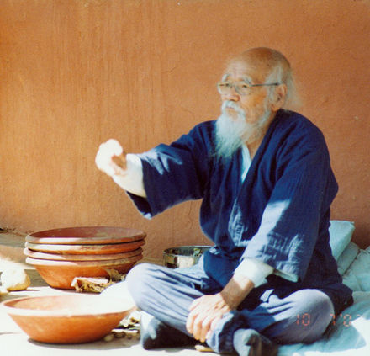
Meet The Grandfather of Natural Farming... Masanobu Fukuoka
Agricultural scientist, farmer, philosopher, admirer of Gandhi.
Awards: Ramon Magsaysay Award, Desikottam Award, Earth Council Award
Author of: “ The One-Straw Revolution” By Masanobu Fukuoka (and 3 other titles)
No-till, no fertilizer, no pesticide, ground mulch and green cover, direct seeding (seed balls)
Watch Videos:
One Straw Revolution - by Masanobu Fukuoka (24.38)
How to do Masanobu Fukuoka's natural farming. (13.28)
Masanobu Fukuoka rice and orchard techniques (5.35)
Masanobu Fukuoka
(1913-2008)
https://en.wikipedia.org/wiki/Masanobu_Fukuoka

Slide 104
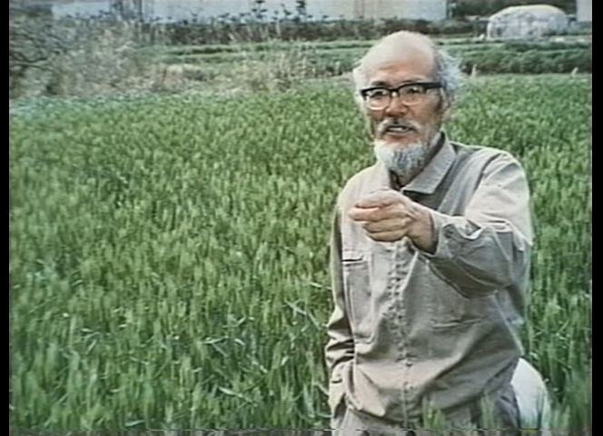
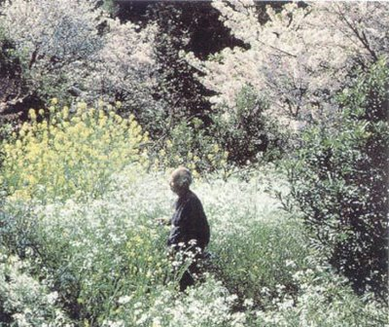
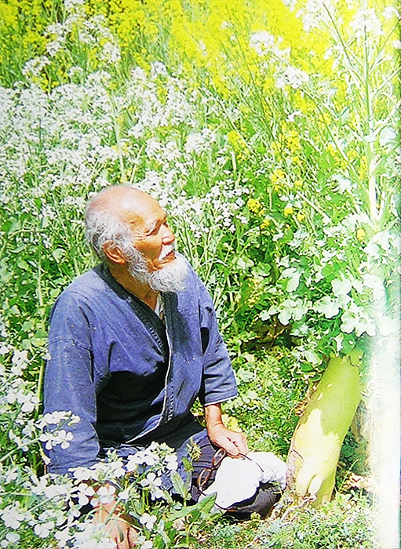
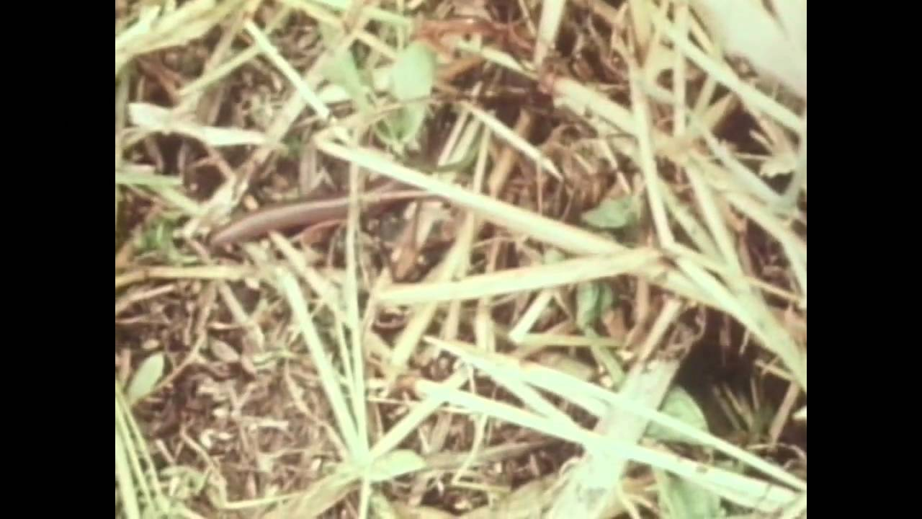
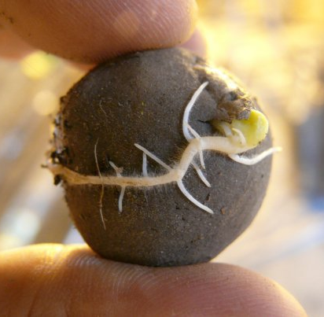
http://2.bp.blogspot.com/-K0CH6gojoxo/UWYcbiSIcgI/AAAAAAAAA8s/XU8F5rdhxI8/s1600/fukuoka-1.png
http://2.bp.blogspot.com/--cXAANZ7iSY/T7Z2rDYPYyI/AAAAAAAAB2c/8nyRgLeBVAc/s1600/masanobu-fukuoka.jpg
http://www.ekoideas.es/blog/wp-content/uploads/ecd48bb9637f1cc6d6067131ec45b942.jpg
http://2.bp.blogspot.com/--cXAANZ7iSY/T7Z2rDYPYyI/AAAAAAAAB2c/8nyRgLeBVAc/s1600/masanobu-fukuoka.jpg
http://i.ytimg.com/vi/XSKSxLHMv9k/maxresdefault.jpg
http://www.vidaenlatierra.com/images/latest-projects/Masanobu-Fukuoka.jpg

Slide 105
Outline
Dimensions of the Food Crisis
Hunger, poverty, production, distribution
Threats to Food Security: Present and Future
Solutions to the Food Crisis
Theoretical (Present) Solution
Food Distribution
Real Solutions
Industrial Agriculture?
Alternative Agriculture
Vegetarianism
What Can You Do?

Slide 106
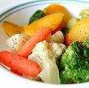

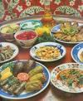
Vegetarianism and Sustainability
Dr R. K. Pachauri, Chairman of IPCC: “We didn’t say it before, but we are saying it now. One of the best ways to fight global warming is to adopt a vegetarian diet”. Speech in Geneva, January 15, 2008

Slide 107
A Crowded Earth
World meat production has surged nearly 5-fold between 1950—1997 (44 → 211 million tons)
The world fish harvest surged 6-fold between 1950-2000 (21 → 120 mi. tons)…per capita consumption tripled.
Per capita meat production stands at 36 kg (> 2x of 1950 level)
~6 bi. humans share the Earth's natural resources with nearly 1 bi. pigs, 1.3 bi. cows, 1.8 bi. sheep and goats, and 13.5 bi. chickens. (~ 3 heads of livestock/ person)

Slide 108
World's Livestock Population Growth
Livestock | 1960 | 1997 | Increase
 | (billion) | (billion) | (percent)
Cattle | 0.94 | 1.33 | 42
Sheep and Goats | 1.34 | 1.77 | 32
Pigs | 0.41 | 0.94 | 131
Chickens | 3.90 | 13.41 | 244
Humans | 3.08 | 5.85 | 90
Source: UN Food and Agriculture Organization, FAOStats, 21 June 1998.

Slide 109
Country-wise Meat Consumption
Country (kg meat/person/yr) | Beef | Pork | Poultry | Mutton | Total
United States | 44 | 31 | 48 | 1 | 123
Germany | 16 | 54 | 15 | 1 | 86
Italy | 26 | 35 | 19 | 2 | 82
United Kingdom | 16 | 25 | 27 | 6 | 74
Brazil | 36 | 9 | 24 | - | 70
New Zealand | 37 | - | - | 29 | 66
China | 5 | 35 | 11 | 2 | 53
Russia | 19 | 13 | 13 | 1 | 46
Japan | 12 | 17 | 12 | 1 | 40
Egypt | 8 | - | 6 | 1 | 16
India | 1 | - | 1 | 1 | 3
Indonesia | - | - | 2 | - | 2
All Industrial Nations | 21 | 25 | 24 | 2 | 72
All Developing Nations | 5 | 11 | 7 | 1 | 24

Slide 110
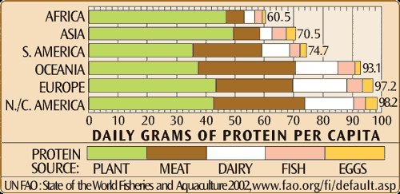
Per Capita Protein Intake: Sources
"10 kcalories (kilogram-calories or 'large calories') of exosomatic energy are spent in the U.S. food system per calorie of food eaten by the consumer. Put another way, the (US) food system consumes ten times more energy than it provides to society in food energy."

Slide 111
Meat Eating and Health Problems
The avg. American consumes nearly twice his or her weight in meat each year.
High growth in consumption of meat (esp. high-fat meat), dairy products and eggs—more cholesterol, saturated fat, and protein.
Global epidemic of lifestyle diseases: heart attacks, strokes and cancers.
Chinese government to limit the country's meat consumption: to avoid massive health care costs (100s of bi. of USD)
https://www.worldwatch.org/node/1626

Slide 112

In China a recent shift to meat-heavy diets has been linked to increases in obesity, cardiovascular disease, breast cancer and colorectal cancer.

Slide 113
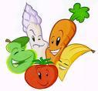
Superiority of Plant Protein
Professor Colin Campbell: “There is a mountain of compelling evidence that so called “low quality” plant protein which allows for slow but steady synthesis of new proteins is the healthiest type of protein”

Slide 114

“Heart Attack Proof” Diet
Diets of Dr. Dean Ornish and Dr. Caldwell Esselstyn keep cholesterol levels below 150, the level below which no one has ever suffered a heart attack.

Slide 115


At the turn of the century, heart disease and cancer used to cause 8% and 4% of deaths.
Now they cause 36% and 22% of deaths.

Slide 116

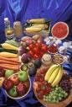

"The vast majority, perhaps 80 percent to 90 percent, of all cancers, cardiovascular diseases, and other forms of degenerative illness can be prevented, at least until very old age, simply by adopting a plant-based diet.“
Dr. T. Colin Campbell
Cornell University

Slide 117
Healthy Human Diet
For infants: mother’s milk.
For adults: fruits, vegetables and whole grains, pulses, nuts .
Barry A. Popkin, Scientific American, June, 2008

Slide 118
Meat Eating—A Net Drain on Economy?
Conservative estimate: excessive meat consumption linked to health care costs of $60—120 bi./yr in USA.
Domestic cash receipts for the meat industry totaled roughly $100 billion in 1997.
It is possible that this industry is a net drain on the American economy.
…Dr. Colin Campbell of Cornell University

Slide 119
Starvation Deaths
1 person dies every second directly or indirectly due to hunger…4000/hr…100,000/day…36 mi. /yr
58 % of all deaths are due to hunger (2001-2004 estimates)
1 child dies every 5 seconds directly or indirectly due to hunger…700/hr…16,000/day…6 mi./yr.
60% of all child deaths are due to hunger (2002-2008 estimates)
http://en.wikipedia.org/wiki/Starvation

Slide 120
Saving Grain for the Hungry
The world already produces enough food for the present 7 billion people; could even support double — 12 billion people.
But 36 % of world's grain (21% in developing countries and 70% in industrial nations) feeds livestock, poultry, and fish farms…inefficient converters of grain
1 kg meat ➔ ~7 kg of grain (corn or wheat)…human food!
670 mi. tons of the world's grain used for feed could feed 800 mi. people.
In 2007, 923 mi. undernourished.

Slide 121
Saving Grain for the Hungry
10% of this feed (67 mi. tons of grain) could sustain 225 mi. people or keep up with world population growth for the next three years.
If each American reduced his meat consumption by only 5 %, (1 dish less/week); the 7.5 mi. tons of grain saved, could feed all the 25 mi. people going hungry in the US each day.

Slide 122
Inefficiency of Protein Production
USA:
7 bi. livestock heads consume 5x grain consumed by the entire American population.
41 mi. tons/yr of plant protein is fed to U.S. livestock to produce 7 mi. tons of animal protein for human consumption.
26 mi. tons of the livestock feed comes from grains and 15 mi. tons from forage crops.
1 kg of high-quality animal protein produced, consumes 6 kg of plant protein.

Slide 123

Energy
In the USA, 20 times as much energy is required to produce one calorie of animal food as is required to produce one calorie of vegetable food

Slide 124
Energy Consumption
 | (Fuel input): (Protein produced)
Chicken | 4:1
Beef | 54:1
Lamb | 50:1
Turkey | 13:1
Pork | 17:1
Eggs | 26:1
Milk | 14:1
Grains | 3.3:1*
(Fossil Fuel input Kcal): Protein produced Kcal)
* Figure pertains to grain farming by conventional methods. This can be made drastically more efficient by using natural farming methods.
http://www.news.cornell.edu/releases/Aug97/livestock.hrs.html

Slide 125
Contribution to Global Climate Change
World’s livestock production is the largest source of anthropogenic methane emissions…EPA
Livestock herds account for ~ 25 % of anthropogenic emissions of methane…climate change.
Stagnant waste lagoons of factory-farm operations emit an additional 5 % percent of human-induced methane.

Slide 126
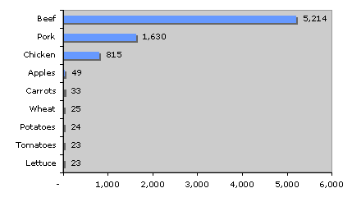
Water Use
U.S. agriculture accounts for 87 % of all the fresh water consumed each year.
Livestock direct use 1.3 %
Livestock total use ~ 50 % ( incl. forage and grain production for livestock)
1 kg beef takes 100 tons of water
1kg wheat takes 0.9 tons of water
1 kg potatoes 0.5 tons of water
Gallons of water to produce 1 lb of various foods ⁽²³⁶⁾

Slide 127
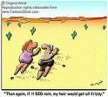
Water
To produce 1 lb. of feedlot beef requires 7 lbs. of feed grain, which takes 7,000 lbs. of water to grow.

Slide 128

One half of all US water resources are used to grow meat.

Slide 129


Pass up one hamburger, and you'll save as much water as you save by taking 40 showers with a low-flow nozzle.
1
=
40

Slide 130

Meat eaters require 14 times as much water for their diets as do vegetarians.

Slide 131
Water Pollution
For example, shifting from pork to chicken requires half the grain, and hence half as much water.
The massive quantities of waste produced by livestock and poultry threaten rivers, lakes and other waterways with pollution, toxic algal blooms and massive fishkills.
US livestock waste is 130 times that produced by humans. ,
Livestock farms are getting larger throughout the world.

Slide 132
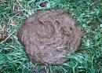
Water Pollution
According to the Environmental Protection Agency, factory farming pollutes U.S. waterways more than all industrial sources combined.

Slide 133
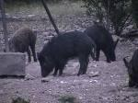
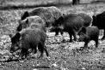
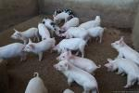
In the U.S., livestock now produce 130 times as much waste as people do. Just one 50,000 acre hog farm in Utah, for example, produces more sewage than the city of Los Angeles!!

Slide 134
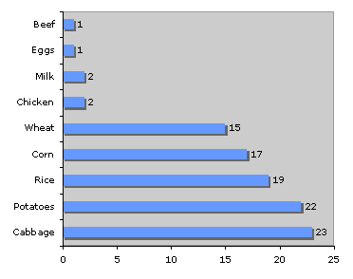
Land
Number of people whose caloric needs can be met on 2.5 acres of land for the following foods ⁽²⁹⁴⁾
According to scientists at the Smithsonian Institute, the equivalent of seven football fields of land is bulldozed every minute, much of it to create more room for farmed animals.

Slide 135
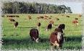
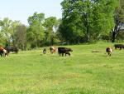
80% of all US agricultural is used in some way to raise animals—that's roughly half of the total land mass of the U.S.

Slide 136
Diet and Land Requirement
S. No. | Diet | Area (sq. yards)/capita | Population that can be supported by Earth. (multiples of 1985 population of ~5 bi.)
1. | Grains | 200 | 60
2. | Potatoes | 600 | 20
3. | Milk | 1500 | 8
4. | Pork | 4000 | 3
5. | Beef | 10000 | 1
Masanabu Fukuoka (translated by Frederic P. Metreaud) “The Natural Way of Farming – The Theory and Practice of Green Philosophy” 1985 Japan Publications Inc. ISBN 0-87040-613-2.

Slide 137
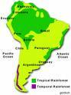
Forest
Of the Amazonian rain forest cleared in South America, more than 38 percent has been used for ranching.

Slide 138

More than 260 million acres of U.S. forest have been cleared to create cropland to grow grain to feed farmed animals.

Slide 139
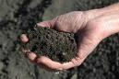
Soil
“85% of topsoil erosion (wind and water) in USA is due to raising animals for food” …Howard Lyman (American Mad Cow Activist)…
This is 13 times above the sustainable rate.
>302 mi. ha devoted to producing feed for the U.S. livestock population (272 mi. ha pasture and 30 mi. ha. cultivated feed grains)
Iowa: Topsoil loss at 30x soil formation rate. Lost 50% of topsoil in just 150 years of farming—soil that took thousands of years to form.

Slide 140

Animal Slaughter and Torture Before Being Killed
Every year, nearly 9 billion animals are killed for food in the United States alone!!
Video: Can you Face the Reality of Factory Farming? (6.08min)
Video: Meet Your Meat (12.48)
Whether animals are raised in factory farms, or in open farms, the slaughter, the pain, the suffering and death are common and inevitable.

Slide 141
Food, Spirituality and Humanity
When plentiful vegetarian food is available.
Yet, humans insist on consuming non-vegetarian food.
It is simply for the sake of one’s tongue.
This is needless “himsa” (unjustified violence).
The highest Dharma (righteousness) is refraining from unjustified violence (ahimsa).
Do we not have any sympathy for the sorrow and suffering of other living beings?

Slide 142
Vegetarianism and Spirituality
The dying animal says “As this person (saḥ) is killing and consuming me (mām) in this lifetime, so shall I kill and consume him in my next lifetime.” This is real meaning of the word ‘māmsaḥ’ (meat) as explained by the wise ones. --Shāstras
The butcher kills for the sake of those who buy and consume the meat.
All are fellow-conspirators in the killing.
As per the law of karma, every action has an equal and opposite reaction. It is inevitable.
So all of them face the same end in their next birth.

Slide 143
Reducing Meat: Win-Win Situation
Massive reductions in meat consumption in industrial nations will ease the healthcare burden while improving public health
Declining livestock herds will take pressure off of rangelands and grainlands, allowing the agricultural resource base to rejuvenate.
Lowering meat consumption worldwide will allow more efficient use of land and water resources. Relevant for increasing population.
Make grain more affordable to the world's chronically hungry.
Humanity becomes more human!

Slide 144
Food Crisis: What can you do?
Avoid MNC-marketed hybridized/GM crops and products.
Eat home-cooked, fresh food; avoid preserved, processed or junk food.
Be vegetarian: Spare the grain for hungry humans. Have a heart! “Don’t turn your stomach into a graveyard for unfortunate dead animals!”—Lokmanya Tilak
Farmer microfinancing options
Local community-operated warehousing, cold storage and food processing/preservation industry for farmers to survive unfair price-fixing, and market crashes.

Slide 145
Reducing Meat: Win-Win Situation
Massive reductions in meat consumption in industrial nations will ease the health care burden while improving public health
Declining livestock herds will take pressure off of rangelands and grainlands, allowing the agricultural resource base to rejuvenate.
Lowering meat consumption worldwide will allow more efficient use of land and water resources. Relevant for increasing population.
Make grain more affordable to the world's chronically hungry.

Slide 146
“When human beings come to understand that animals also experience pleasure and pain they will acquire a new dimension of wisdom. It is because of our human sense of duty and our higher understanding that we should be sympathetic to all living beings.”
P.R. Sarkar

Slide 147
Outline
Dimensions of the Food Crisis
Hunger, poverty, production, distribution
Threats to Food Security: Present and Future
Solutions to the Food Crisis
Theoretical (Present) Solution
Food Distribution
Real Solutions
Industrial Agriculture?
Alternative Agriculture
Vegetarianism
What Can You Do?

Slide 148
Food Crisis: What can you do?
Support local produce: local farmers, retailers
Grow your own food: urban gardens, community gardens/farms, terrace gardens.
Adopt low input, small-scale, biodiverse, organic/natural farming methods integrated with sustainable land and watershed management.
Both farmers and consumers should support crop diversity. Plant and purchase delicious and nutritious minor millets, pulses and vegetables.

Slide 149
Food Crisis: What can you do?
Avoid MNC-marketed hybridized/GM crops and products.
Eat home-cooked, fresh food; avoid preserved, processed or junk food.
Be vegetarian: Spare the grain for hungry humans. Have a heart! “Don’t turn your stomach into a graveyard for unfortunate dead animals!”—Lokmanya Tilak
Farmer microfinancing options
Local community-operated warehousing, cold storage and food processing/preservation industry for farmers to survive unfair price-fixing, and market crashes.

Slide 150
Food Crisis: What can you do?
Ensure dignity of farmers and workers
Ensure living wages
Work for a profound rural change:
Land reforms, education, health, infrastructure
Provide restitution for the injustices of the past and present
Developed countries to avoid exploitative practices and policies by their govts and MNCs towards poor countries.
Cancel debts of poorer countries.

Slide 151
Food Crisis: What can you do?
Enable distribution of surplus food to poor countries
Fuel plantations must be restricted to marginal lands. Other alternative energy/fuel sources should be researched and promoted.
Stop war: Promote peace negotiations; resolve issues reg. sharing of scarce resources, religious intolerance and hatred.
Limit global warming and pollution, land degradation, deforestation, etc.

Slide 152
Reading and Video Resources
“ The One-Straw Revolution” By Masanobu Fukuoka (and 3 other titles)
No-till, no fertilizer, no pesticide, ground mulch and green cover, direct seeding (seed balls)
“Rishi Krishi” By Mohan Shankar Deshpande
Angara, earthworms, amritapani, natural pesticides
“Permaculture” By Bill Mollison
Sustainable community, planned designs, natural patterns
Food Forests in 7 minutes (7 min) with Geoff Lawton.
300 Year Old Food Forest in Vietnam (6 min) with Geoff Lawton
Farming - The Gandhian Way - A Tribute to Shri. BHASKAR SAVE
Nero's Guests by P. Sainath.

Slide 153
Learning is not compulsory…neither is survival.
--W. Edwards Deming

